Slide 1


CSS TRANSITIONS AND ANIMATIONS

Slide 2
TRANSITIONS
CSS transitions provide a way to control animation speed when changing CSS properties. Instead of having property changes take effect immediately, you can cause the changes in a property to take place over a period of time. For example, if you change the color of an element from white to black, usually the change is instantaneous. With CSS transitions enabled, changes occur at time intervals that follow an acceleration curve, all of which can be customized.

Slide 3
TRANSITIONS - PROPERTIES
transition-property: color;
transition-duration: 4s;
transition-timing-function: ease-in-out;
transition-delay: 1s;

Slide 4
TRANSITIONS - SHORTHAND
/* property name | duration | timing function | delay */
transition: color 4s ease-in-out 1s;

Slide 5
TRANSITIONS - TIMING FUNCTIONS
Mathematical function that describes how fast one-dimensional values change during animations. This lets you vary the animation's speed over the course of its duration.
"Smooth" timing functions are often called easing functions. They correlate a time ratio to an output ratio, both expressed as s. For these values, 0.0 represents the initial state, and 1.0 represents the final state.

Slide 6
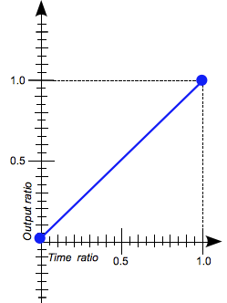
TIMING FUNCTIONS - LINEAR
The animation moves from beginning to end at a constant rate. This keyword represents the timing function
cubic-bezier(0.0, 0.0, 1.0, 1.0)

Slide 7
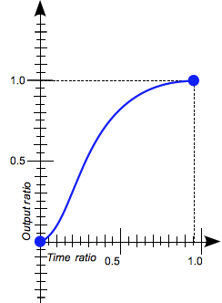
TIMING FUNCTIONS - EASE
The animation starts slowly, accelerates sharply, and then slows gradually towards the end. This keyword represents the timing function
cubic-bezier(0.25, 0.1, 0.25, 1.0)
It is similar to ease-in-out, though it accelerates more sharply at the beginning.

Slide 8
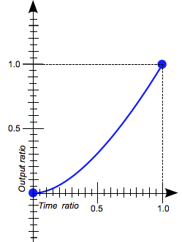
TIMING FUNCTIONS - EASE-IN
The animation starts slowly, and then progressively speeds up until the end, at which point it stops abruptly. This keyword represents the timing function
cubic-bezier(0.42, 0.0, 1.0, 1.0)

Slide 9
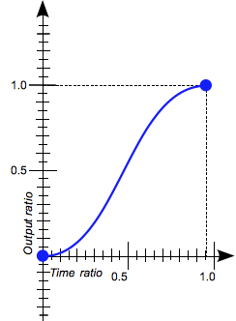
TIMING FUNCTIONS - EASE-IN-OUT
The animation starts slowly, speeds up, and then slows down towards the end. This keyword represents the timing function
cubic-bezier(0.42, 0.0, 0.58, 1.0)
At the beginning, it behaves like the ease-in function; at the end, it is like the ease-out function.

Slide 10
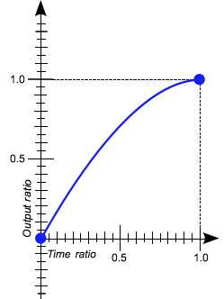
TIMING FUNCTIONS - EASE-OUT
The animation starts abruptly, and then progressively slows down towards the end. This keyword represents the timing function
cubic-bezier(0.0, 0.0, 0.58, 1.0)

Slide 11
TIMING FUNCTIONS - STEPS
The steps() functional notation defines a step function dividing the domain of output values in equidistant steps.

Slide 12
TRANSITIONS - DEMO

Slide 13
ANIMATIONS
CSS Animations is a module of CSS that lets you animate the values of CSS properties over time, using keyframes. The behavior of these keyframe animations can be controlled by specifying their timing function, duration, their number of repetitions, and other attributes.

Slide 14
TRANSITIONS - PROPERTIES - 1
animation-delay
Configures the delay between the time the element is loaded and the beginning of the animation sequence.
animation-direction
Configures whether or not the animation should alternate direction on each run through the sequence or reset to the start point and repeat itself.
animation-duration
Configures the length of time that an animation should take to complete one cycle.
animation-iteration-count
Configures the number of times the animation should repeat; you can specify infinite to repeat the animation indefinitely.

Slide 15
TRANSITIONS - PROPERTIES - 1
animation-name
Specifies the name of the @keyframes at-rule describing the animation’s keyframes.
animation-play-state
Lets you pause and resume the animation sequence.
animation-timing-function
Configures the timing of the animation; that is, how the animation transitions through keyframes, by establishing acceleration curves.
animation-fill-mode
Configures what values are applied by the animation before and after it is executing.

Slide 16
USING KEYFRAMES
The @keyframes CSS at-rule controls the intermediate steps in a CSS animation sequence by defining styles for keyframes (or waypoints) along the animation sequence. This gives more control over the intermediate steps of the animation sequence than transitions.

Slide 17
USING KEYFRAMES
@keyframes slidein {
from {
transform: translateX(-20rem);
opacity: 0;
}
to {
transform: translateX(0);
opacity: 1;
}
}

Slide 18
USING KEYFRAMES
@keyframes slidein {
0% {
transform: translateX(-20rem);
opacity: 0;
}
50% {
transform: translateX(10rem);
}
100% {
transform: translateX(0);
opacity: 1;
}
}

Slide 19
ANIMATIONS - DEMO

Slide 20
Resources

Slide 21
Resources
https://developer.mozilla.org/en-US/docs/Web/CSS/CSS_animated_properties

Slide 22
RESOURCES - TRANSITIONS
https://developer.mozilla.org/en-US/docs/Web/CSS/CSS_Transitions
https://developer.mozilla.org/en-US/docs/Web/CSS/CSS_Transitions/Using_CSS_transitions
https://css-tricks.com/almanac/properties/t/transition/
https://easings.net/
https://blog.alexmaccaw.com/css-transitions
https://www.adobe.com/devnet/archive/html5/articles/using-css3-transitions-a-comprehensive-guide.html
https://css-tricks.com/different-transitions-for-hover-on-hover-off/
http://joelb.me/blog/2012/maintaining-css-style-states-using-infinite-transition-delays/

Slide 23
RESOURCES - ANIMATIONS
https://developer.mozilla.org/en-US/docs/Web/CSS/CSS_Animations
https://developer.mozilla.org/en-US/docs/Web/CSS/CSS_Animations/Using_CSS_animations
https://developer.mozilla.org/en-US/docs/Web/CSS/@keyframes
https://css-tricks.com/almanac/properties/a/animation/
https://daneden.github.io/animate.css/

